Slide 1
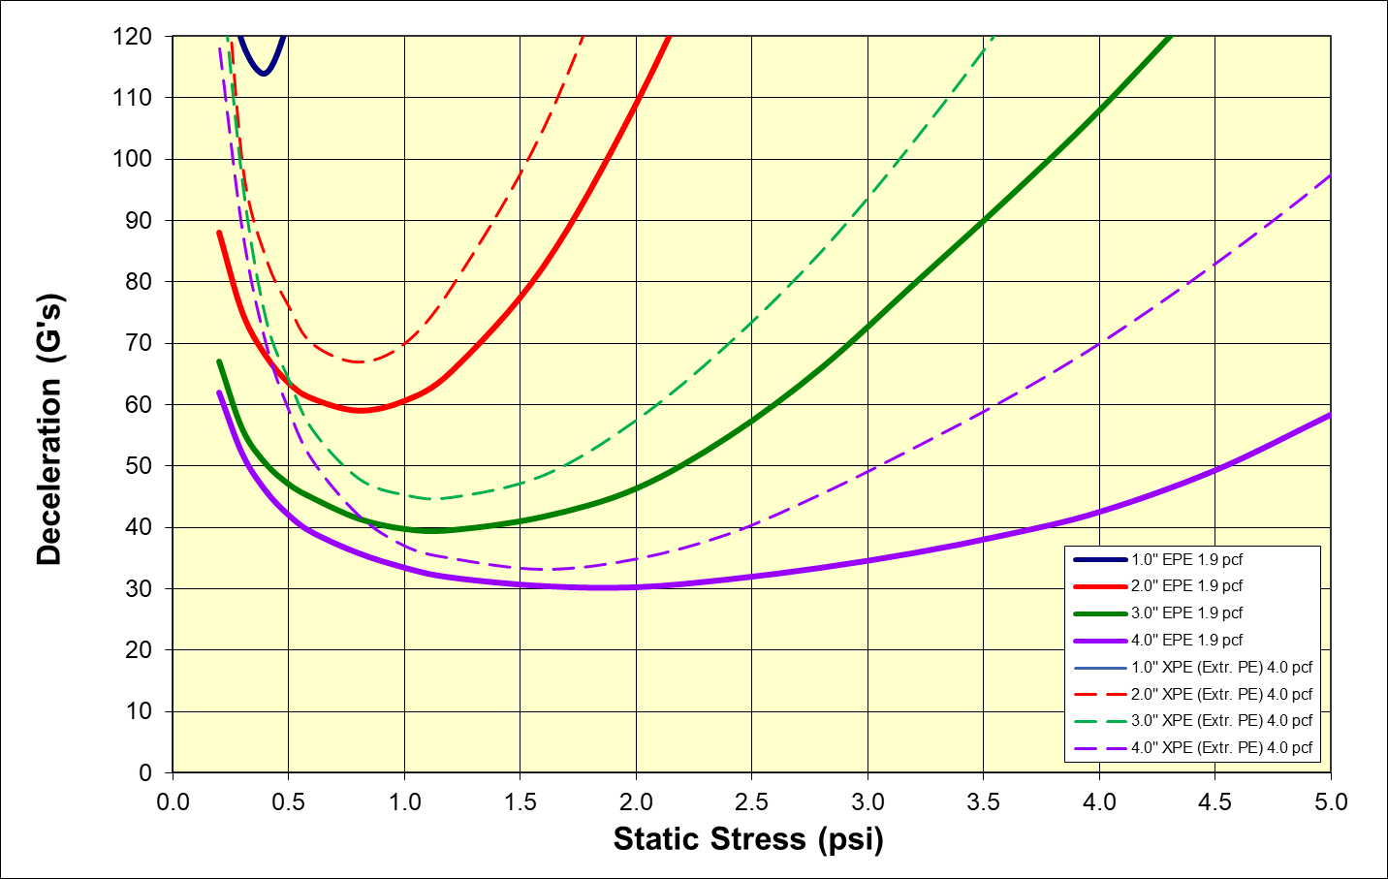
Cushioning Curve 36” Drop 2nd thru 5th
Scale
120 G’s
5.0 psi

Slide 2
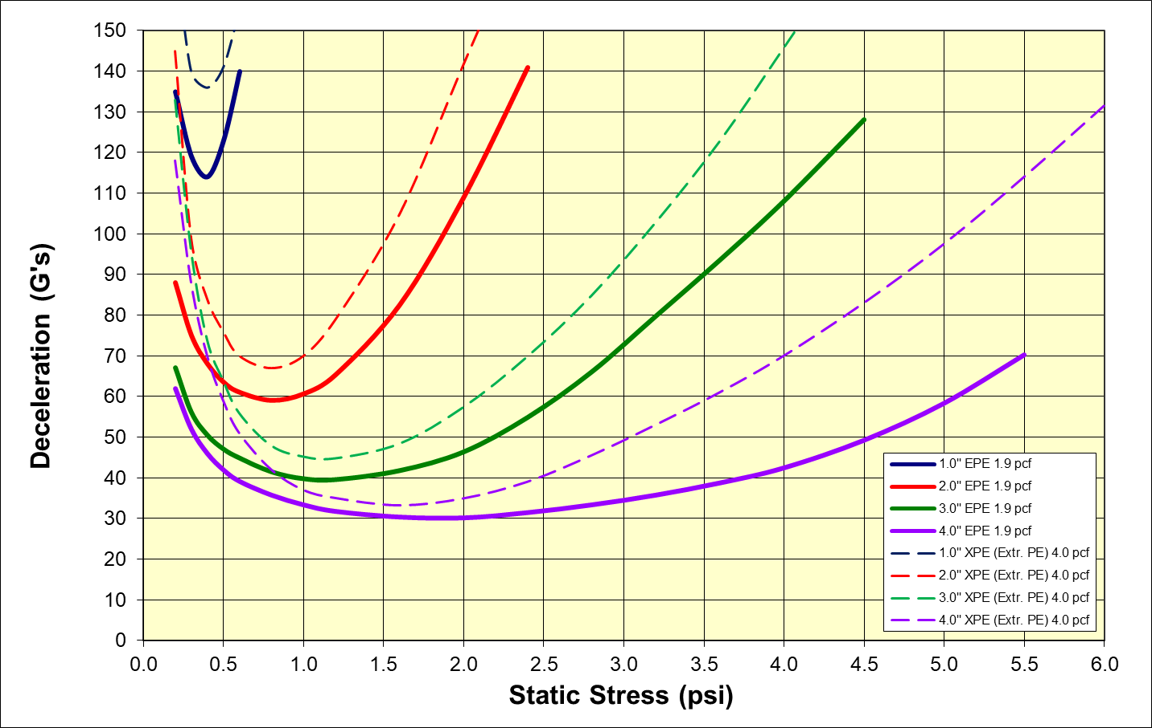
Cushioning Curve 36” Drop 2nd thru 5th
Scale
150 G’s
6.0 psi

Slide 3
Cushioning Curve 36” Drop 2nd thru 5th
Design Recommendations
Optimal Loading for XPE (Extruded PE) 4.0 pcf
2” Thick = 0.8 psi (67 G – Best Case)
3” Thick = 1.1 psi (45 G – Best Case)
4” Thick = 1.7 psi (33 G – Best Case)
Optimal Loading for EPE (ARPLANK) 1.9 pcf
2” Thick = 0.8 psi (59 G – Best Case)
3” Thick = 1.1 psi (40 G – Best Case)
4” Thick = 1.7 psi (30 G – Best Case)
Use of 1.9 pcf ARPLANK EPE vs. 4.0 pcf XPE yields a 10 to 13% improvement in G force reduction.

